Slide 1
Chapter 37
Relativity

Slide 2
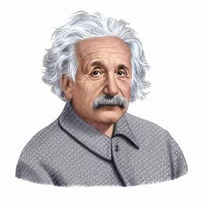
The Special Theory of Relativity

Slide 3
Covering:
Galilean-Newtonian Relativity
Postulates of the Special Theory of Relativity
Simultaneity
Time Dilation and the Twin Paradox
Length Contraction
Four-Dimensional Space-Time

Slide 4
Galilean-Newtonian Relativity
Definition of an inertial reference frame:
One in which Newton’s first law is valid
Earth is rotating and therefore not an inertial reference frame, but can treat it as one for many purposes
A frame moving with a constant velocity with respect to an inertial reference frame is itself inertial

Slide 5
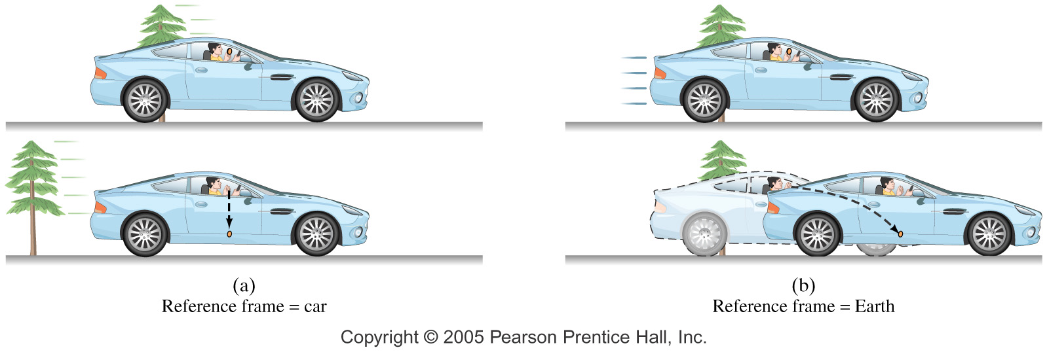
Galilean-Newtonian Relativity
Relativity principle:
The basic laws of physics are the same in all inertial reference frames.

Slide 6
Galilean-Newtonian Relativity
This principle works well for mechanical phenomena.
However, Maxwell’s equations yield the velocity of light; it is 3.0 x 10⁸ m/s.
So, which is the reference frame in which light travels at that speed?
Scientists searched for variations in the speed of light depending on the direction of the ray, but found none.

Slide 7
Postulates of the Special Theory of Relativity
The laws of physics have the same form in all inertial reference frames.
Light propagates through empty space with speed c independent of the speed of source or observer.
This solves the problem – the speed of light is in fact the same in all inertial reference frames.

Slide 8
Simultaneity
One of the implications of relativity theory is that time is not absolute. Distant observers do not necessarily agree on time intervals between events, or on whether they are simultaneous or not.
In relativity, an “event” is defined as occurring at a specific place and time.

Slide 9
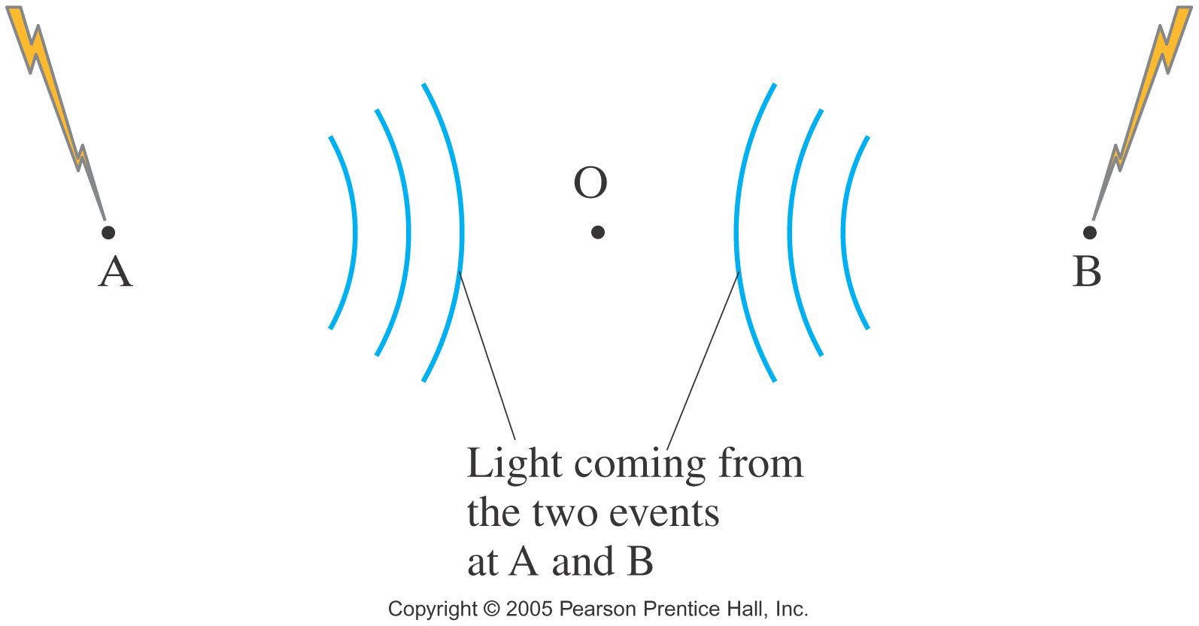
Simultaneity
Thought experiment: Lightning strikes at two separate places. One observer believes the events are simultaneous – the light has taken the same time to reach her – but another, moving with respect to the first, does not.

Slide 10
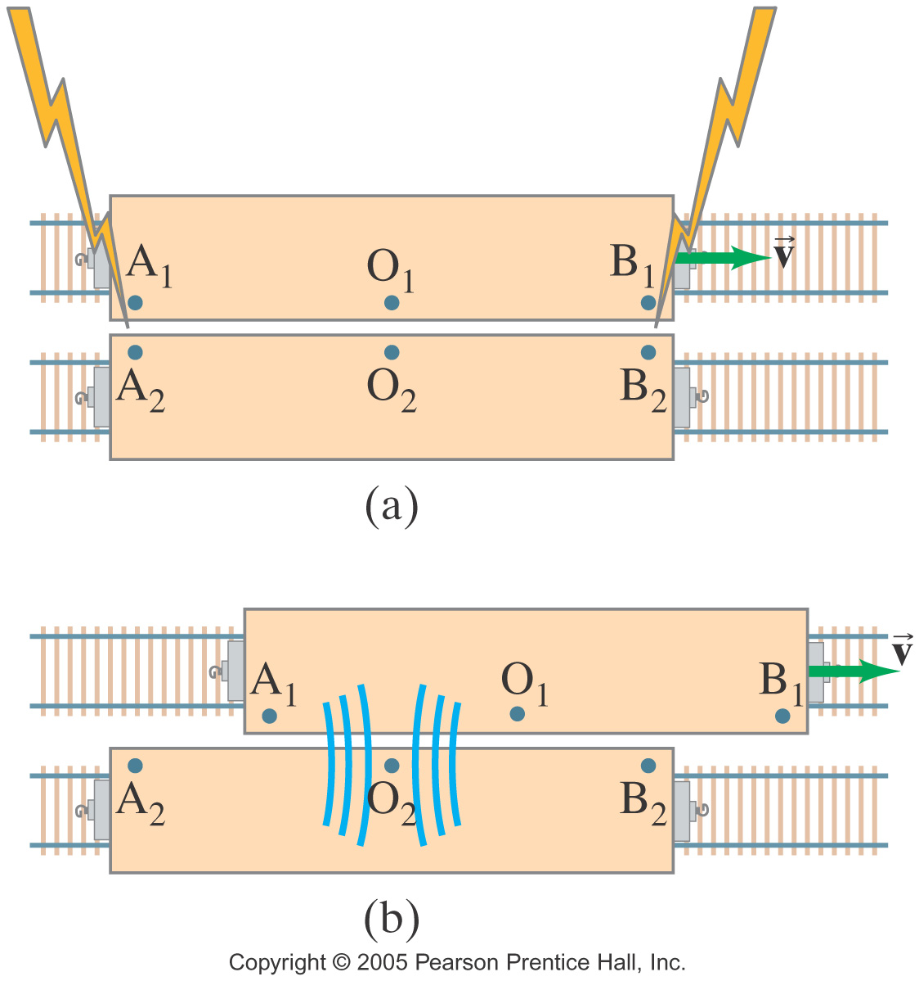
Simultaneity
Here, it is clear that if one observer sees the events as simultaneous, the other cannot, given that the speed of light is the same for each.

Slide 11
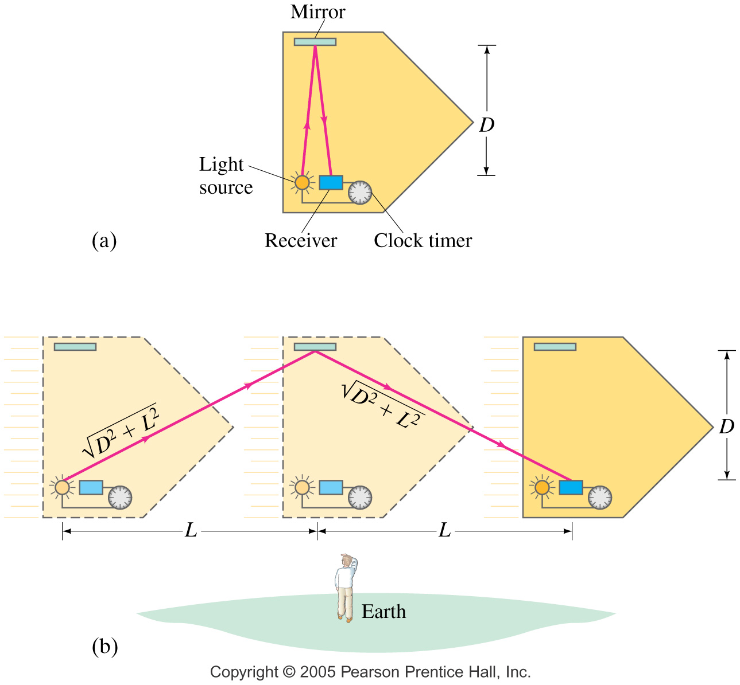
Time Dilation and the Twin Paradox
A different thought experiment, using a clock consisting of a light beam and mirrors, shows that moving observers must disagree on the passage of time.

Slide 12
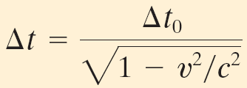
Time Dilation and the Twin Paradox
Calculating the difference between clock “ticks,” we find that the interval in the moving frame is related to the interval in the clock’s rest frame:
(26-1a)

Slide 13
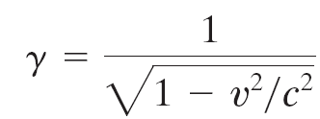
Time Dilation and the Twin Paradox
The factor multiplying t₀ occurs so often in relativity that it is given its own symbol, γ.
(26-2)
We can then write:
(26-1b)

Slide 14
Time Dilation and the Twin Paradox
To clarify:
The time interval in the frame where two events occur in the same place is t₀.
The time interval in a frame moving with respect to the first one is Δt.

Slide 15
Time Dilation and the Twin Paradox
It has been proposed that space travel could take advantage of time dilation – if an astronaut’s speed is close enough to the speed of light, a trip of 100 light-years could appear to the astronaut as having been much shorter.
The astronaut would return to Earth after being away for a few years, and would find that hundreds of years had passed on Earth.

Slide 16
Time Dilation and the Twin Paradox
This brings up the twin paradox – if any inertial frame is just as good as any other, why doesn’t the astronaut age faster than the Earth traveling away from him?
The solution to the paradox is that the astronaut’s reference frame has not been continuously inertial – he turns around at some point and comes back.

Slide 17
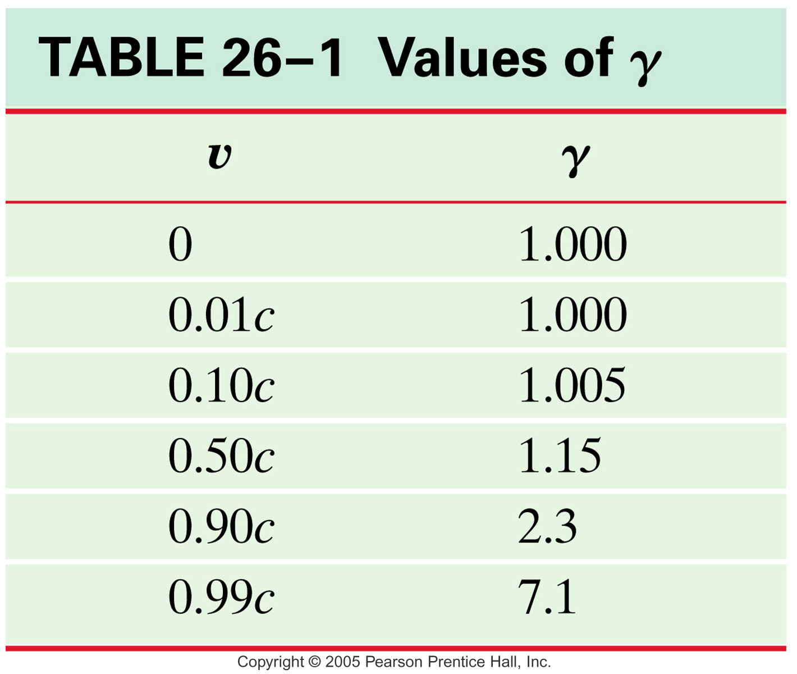
Time Dilation and the Twin Paradox

Slide 18
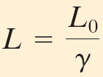
Length Contraction
If time intervals are different in different reference frames, lengths must be different as well. Length contraction is given by:
(26-3a)
or
(26-3b)
Length contraction occurs only along the direction of motion.

Slide 19
Four-Dimensional Space-Time
Space and time are even more intricately connected. Space has three dimensions, and time is a fourth. When viewed from different reference frames, the space and time coordinates can mix.

Slide 20
Relativistic Momentum and Mass
Expressions for momentum and mass also change at relativistic speeds.
Momentum:
(26-4)
Gamma and the rest mass are sometimes combined to form the relativistic mass:
(26-5)

Slide 21
The Ultimate Speed
A basic result of special relativity is that nothing can equal or exceed the speed of light. This would require infinite momentum – not possible for anything with mass.

Slide 22
E = mc²; Mass and Energy
At relativistic speeds, not only is the formula for momentum modified; that for energy is as well.
The total energy can be written:
(26-7b)
Where the particle is at rest,
(26-8)

Slide 23
E = mc²,
where m = γ mo, is the boosted mass, & can be converted into energy and energy into mass. This is derived from
W = ∫Fdx = ∫[ d(γ mo v)/dt]dx
by calculus. (Derive on the board.)
This equation initiated the nuclear age.

Slide 24
Mass and Energy
Combining the relations for energy and momentum gives the relativistic relation between them:
A photon has no rest mass, therefore, for it only, E = pc.

Slide 25
Relativistic Addition of Velocities
Relativistic velocities cannot simply add; the speed of light is an absolute limit.
Lorentz transformations:
x’ =γ(x-ut), y’ = y, z’ = z, t’ = γ(t-ux/c²)
lead to (show on board):
v = (v’ + u)/(1 + uv’/c²),
where u is relative speed of two observers.

Slide 26
The Impact of Special Relativity
The predictions of special relativity have been tested thoroughly, and verified to great accuracy.
The correspondence principle says that a more general theory must agree with a more restricted theory where their realms of validity overlap.
Correspondence principle: when v << c, Newton’s Laws apply because m = m₀ .

Slide 27
General Relativity
Equivalence principle
Gravitational redshift
Geodesics
Gravitational light bending

Slide 28
A. Local equivalence principle: Gravity and acceleration are locally equivalent, as long as you are confined to observing within an infinitesimally small space.
B. Space-time curvature and acceleration equivalence: a product of the math of curved spaces.
A and B imply gravity is equivalent to curved space-time. This is the basis of Einstein’s Field Equations. They provide physics for all observers, accelerated or not—that’s why it’s called General Relativity.
Special Relativity is a limiting special case of General Relativity for v = constant.

Slide 29
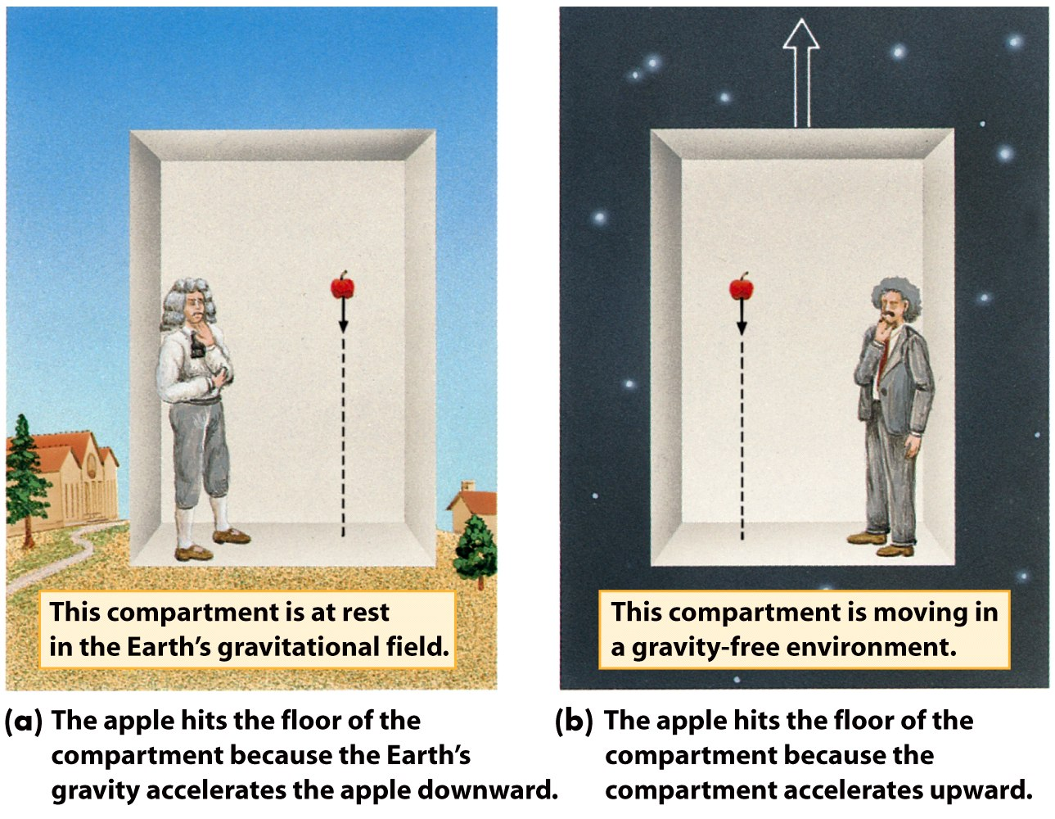
Equivalence principle

Slide 30
Gravitational redshift

Slide 31
Gravitational Redshift
Light is emitted from the surface of a white dwarf (mass of one solar mass, radius of one Earth radius) at a frequency of 5×10¹⁴ Hz. At what frequency do we observe the Earth with a telescope on Earth?
Fractional change is 2×10⁻⁴.
Gravitational time dilation follows the same equation.

Slide 32
Einstein’s theory of gravity is built on the principle that
The speed of light is constant.
As an object speeds up its clock runs faster.
The effects of gravity cannot be distinguished from the effects of acceleration in the absence of gravity.
Everyone’s relative.

Slide 33
Gravity deforms space-time

Slide 34
General Relativistic Metric (GRM): ds² = g_{μν}dx^{μ}dx^{ν} in 4-D (repeated indices are summed). g_{μν} = g_{νμ}, a symmetric tensor, thus having 10 unique components. For a coordinate transformation, g_{μν} ‘= (∂x^{α}/∂x_{μ}’)(∂x^{β}/∂x_{ν}’) g_{αβ}. g^{ρσ}g_{στ} = δ^{ρ}_{τ}, where δ^{ρ}_{τ} = 1 for ρ = τ, 0 otherwise. Covariant vectors have lower indices and contravariant vectors have higher. Transformations between them: A_{μ} = g_{μν}A^{ν} and A^{μ} = g^{μν}A_{ν}. Many tensors can be multiplied like matrices.

Slide 35
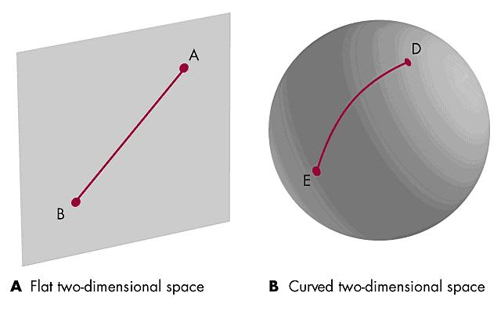
Geodesics in curved spacetime

Slide 36
Special Relativity Metric: for v = constant, ds² = c²dt² - dx² - dy² - dz². GRM → Field Equations (10 eqns because of μν symmetry): R^{μν} = Λg^{μν} – K [T^{μν} – (1/2) g^{μν}T], where R^{μν} is the curvature tensor of space-time, Λ is the cosmological constant, and T^{μν} is the matter energy tensor and T = g^{μν}T_{μν}, K = 8πG/c².

Slide 37
BLACK HOLE MATH: The Schwarzschild Metric (non-rotating, spherically symmetric black hole): Solution of Field equations: ds² = c² (1- 2Gm/c²r) dt² - dr²/ (1-2Gm/ c²r) – r²(dΘ² + sin²Θdφ²)

Slide 38
Test of GR: Gravity bends the path of light

Slide 39
Another GR Test: Precession of Mercury’s orbit

Slide 40
Note that the dr term blows up for r = r_{Sch}= 2GM/ c² = 3km(M/M_{sun}). Here time is overpowered by space and is relatively infinitely dilated relative to a distant observer. This is the radius of the event horizon (Schwarzschild Radius), where escape speed becomes the speed of light. This also can be derived from E + U = 0, (1/2)mv² - Gm’m/r = 0, setting v = c.

Slide 41
Does tidal force of black hole rip you apart? Classic tidal force F ≈ (2d/r³)Gmm’. For a mass of 2 million solar masses = 2 x 10⁶ x 1.9 x 10³⁰ kg, the tidal force at the event horizon is 0.328 N. For smaller black holes, the force can become way larger, for larger back holes smaller. So, supermassive black holes do not rip you apart at the event horizon, but at the center called the singularity, gravity can become very strong and crunch you unless the black hole is rotating rapidly, in which case a wormhole (bh→white hole) is possible.

